Slide 1
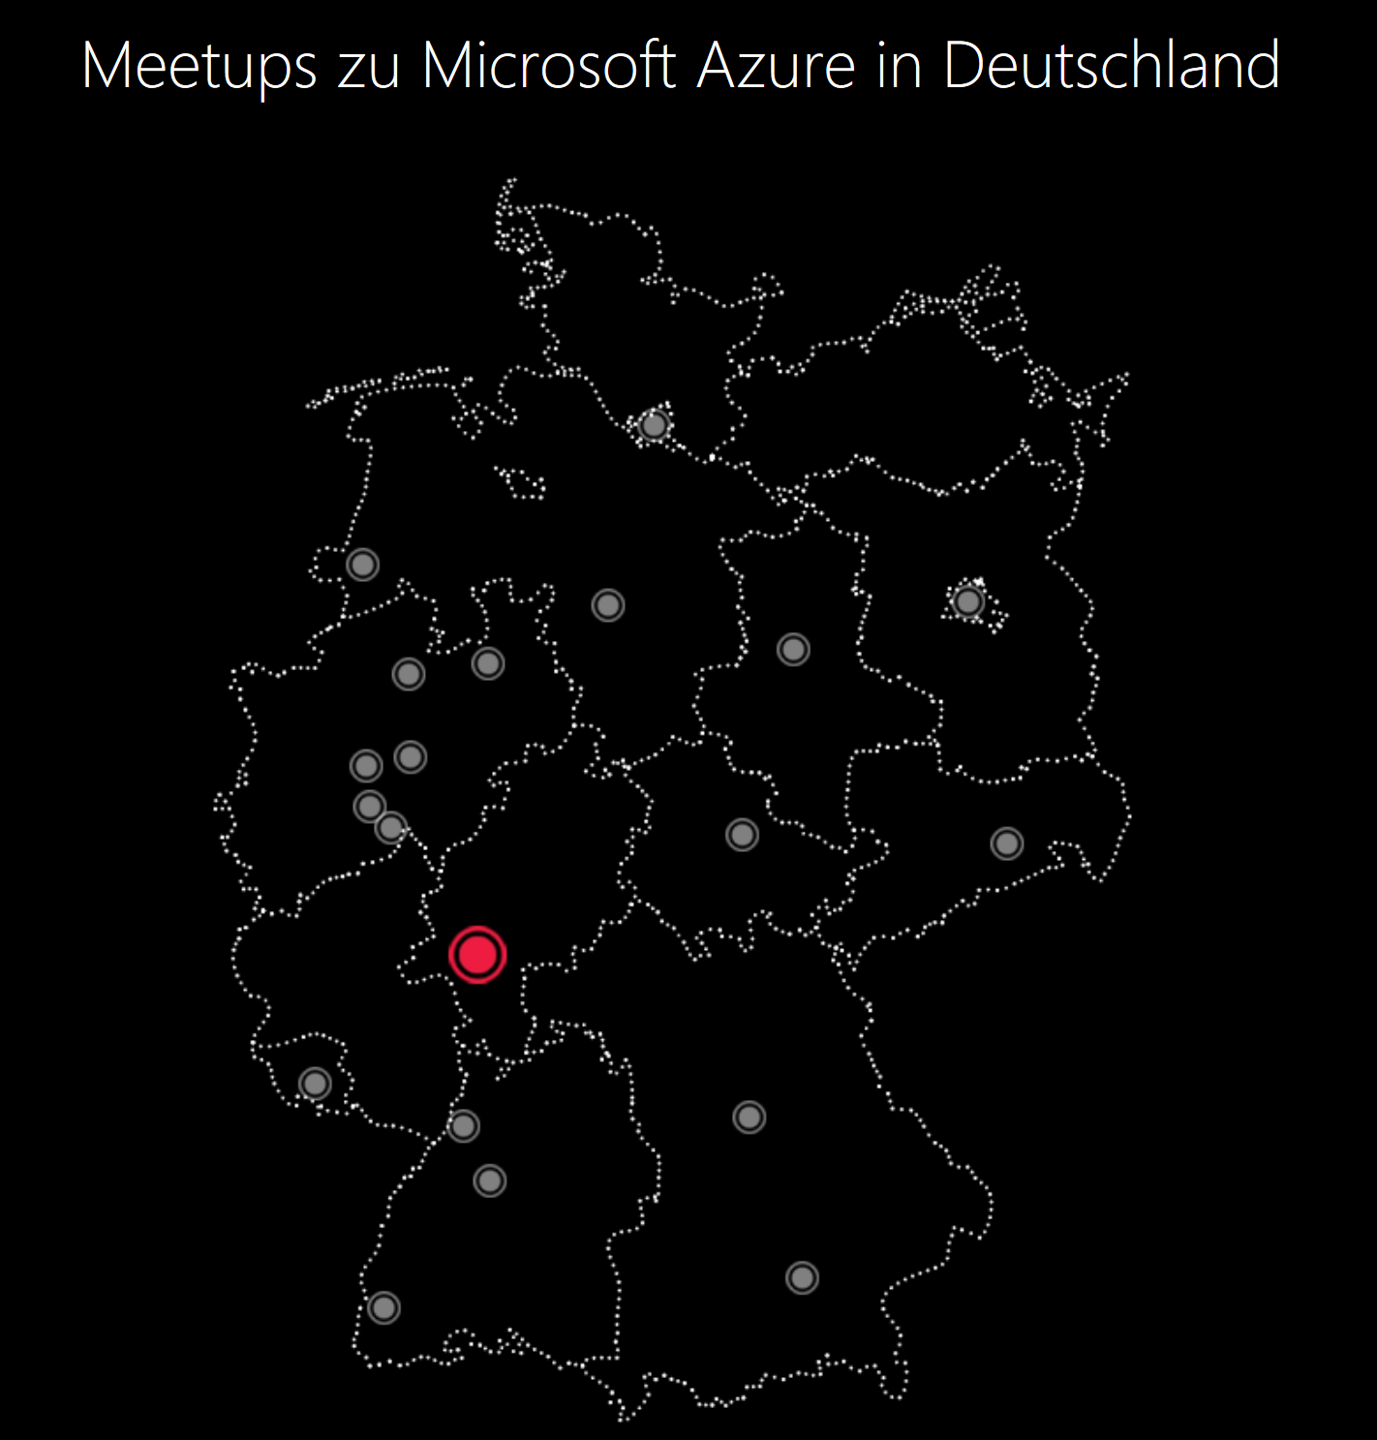
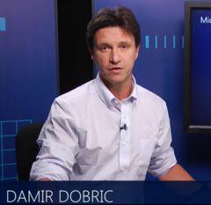
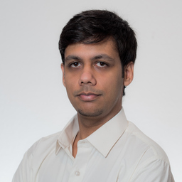
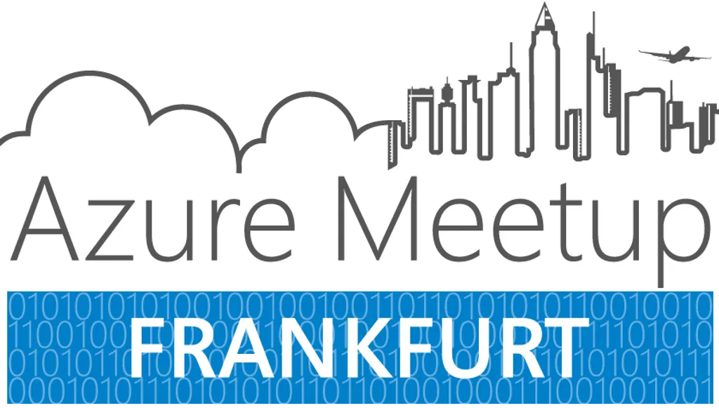

Wifi EventCode
Frankfurt22
Damir Dobric
Indraneel Pole

Slide 3
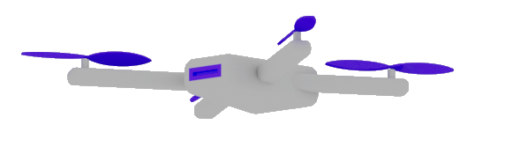
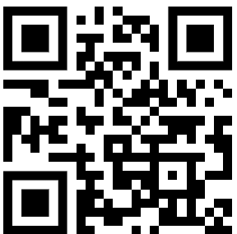
Semantic Kernel
Dr. Damir Dobric
Lead Software Architect daenet GmbH / ACP Digital
Microsoft Regional Director,
Most Valuable Professional: Azure + IoT

Slide 4
AI Services
Open AI
https://platform.openai.com/docs/models
Azure Open AI https://oai.azure.com/portal/****/models
Request Access to Azure OpenAI Service (microsoft.com)

Slide 5
DEMO
Open AI Playground
Azure Open AI Playground

Slide 6
Generative Model Types
Embeddings Models
Completion Models
Chat Models
Semantic Search Applications
The application is based on Completion (prompts)
Chat-GPT Application

Slide 7
Completion Models
Summarize following scientific abstract, using a user-friendly language.
[Abstract] Sparse representation has attracted much attention from researchers in fields of signal processing, image processing, computer vision, and pattern recognition. Sparse representation also has a
good reputation in both theoretical research . . .

Slide 8
Chat Models
Bot: How can I help you?
User: What's the weather like today?
Bot: Where are you located?
User: I'm in Frankfurt.
Bot: It’s 22 degrees and sunny in Frankfurt today.
User: Thanks! Can you explain scientific abstracts?
Bot: Yes. Please provide abstract.

Slide 9
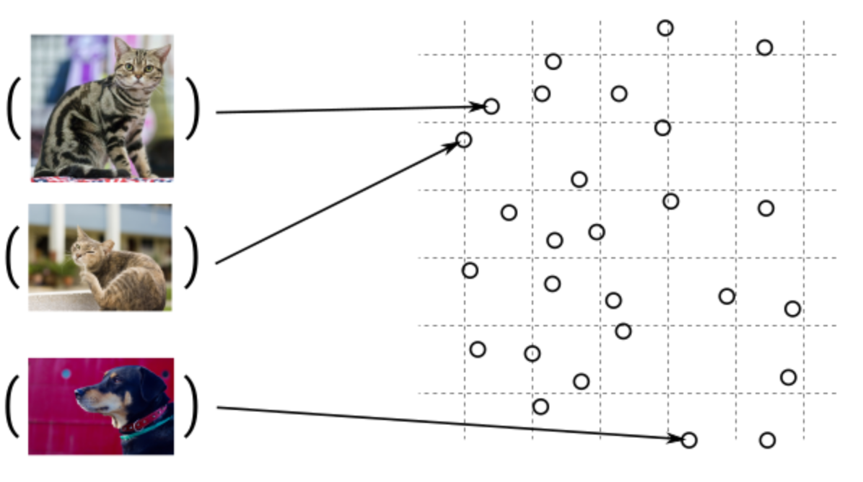
Guess, today is a nice day in Palma
Embedding Models
Today is a typical German rainy day
Two things are infinite: the universe and human stupidity; and I'm not sure about the universe.

Slide 10
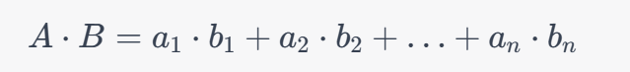
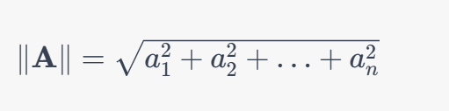
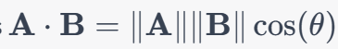
Similarity Between Multidimensional Vectors
Dot Product
The Norm
Cosine Similarity

Slide 11
When to use Embeddings?
Semantic Search
Classification
Clustering
Recommendations
. . .

Slide 12
What is a token?
1 token ~= 4 chars in English
1 token ~= ¾ words
100 tokens ~= 75 words
Byte Pare Encoding (Gage,1994): Wikipedia
Tokenizer: https://platform.openai.com/tokenizer
What are tokens and how to count them?
Token Pricing: Pricing (openai.com)

Slide 13
SEMANTIC KERNEL

Slide 14

Software V2
The new Generation of Software
“After tomorrow”
“Tomorrow”
Quantum Computing
Software
Today
AI & Large Language Model Integration
Syntax Driven Languages

Slide 15
Semantic Kernel is an open-source SDK that lets you easily combine Generative AI Models syntactic programming languages like C#, Python an JAVA.
Currently supported languages: C#, Python
Currently supported AI Services: OpenAI, Azure OpenAI, and Hugging Face
Introduction | 🦜️🔗 Langchain

Slide 16
What is an Agent?
An agent is an AI that can:
Answer questions
Automate processes for users
. . .

Slide 17
What is a Copilot?
A Copilot is an AI application that consists of one or more agents,
which orchestrate tasks.

Slide 18
Why to use SK?
SK is a framework to build agents
You can easily use LLM models for chat, create images and video so on.
Making automated Agents that automate business processes is hard?
You need a framework for such complex engineering tasks.

Slide 19
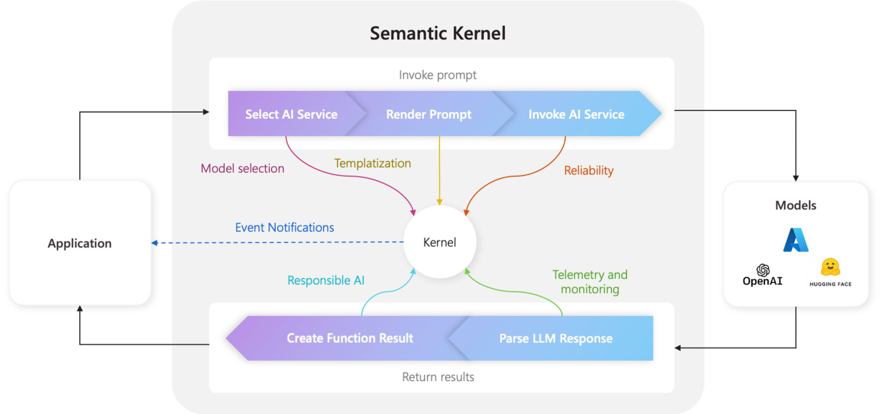
Architecture of the “Smart” application

Slide 20
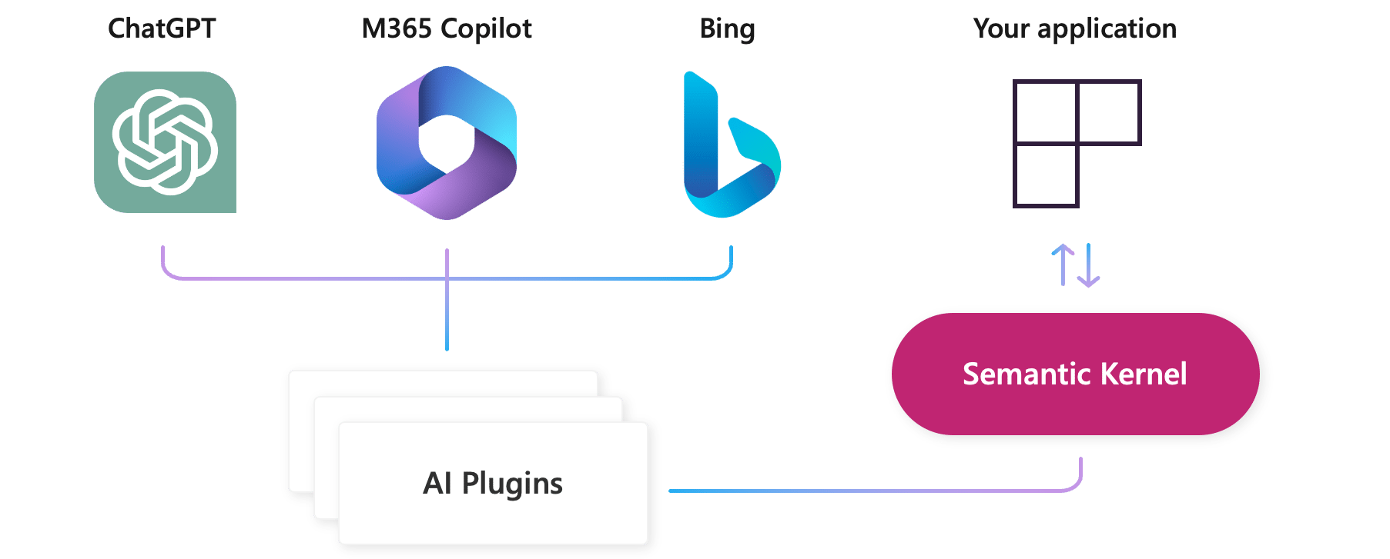
AI Plugins
Your SK application
a plugin is a group of functions
that can be exposed to AI applications
OpenAI plugin specification

Slide 21
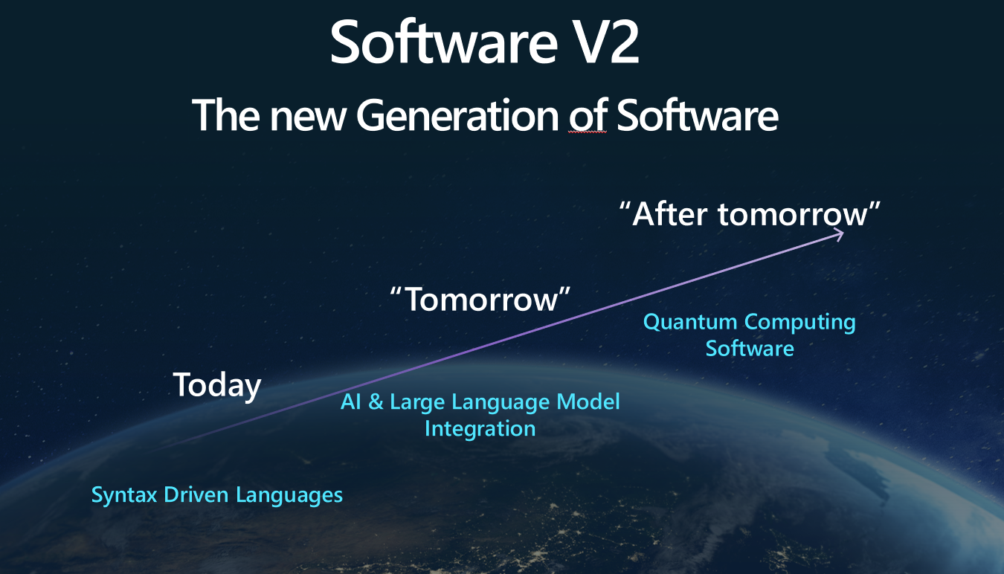
The Knowledge is inside Plugins
Native Functions (C#, Python, JAVA, ??)
Prompts (Semantic Functions)

Slide 22
NATIVE FUNCTIONS
[SKFunction, Description("Gets the UTC current time.")]
public string UtcNow()
{
return DateTime.UtcNow.ToString();
}
A native function is a function
defined by the code

Slide 23
PROMPTS (SEMANTIC FUNCTIONS)
Inline Functions
string prompt = @"Bot: How can I help you?
User: {{$input}}
---------------------------------------------
The intent of the user in 5 words or less: ";
A semantic function is a function
defined by the LLM prompt
Plugins
│
│─── Plugin1
│
│─── Function11
│─── Function12
└─── Plugin2
│
│─── Function21
│─── Function22
Add Ins
In-file Functions

Slide 24
DEMO
Controlling the lighting system

Slide 25
Deep Dive into Semantic Kernel
Overview of the kernel
Creating native functions
Creating semantic functions
Understanding AI plugins
Planer
Create and run a ChatGPT plugin

Slide 26
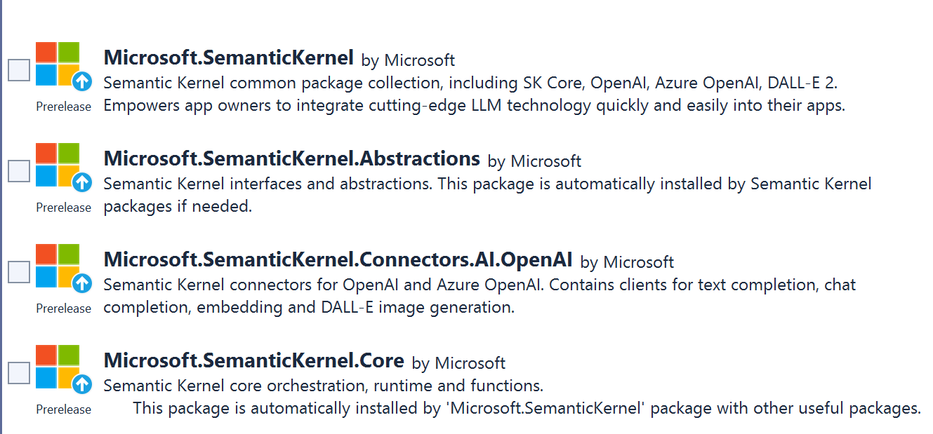
SEMANTIC KERNEL OVERVIEW

Slide 27
Semantic Kernel Initialization with OpenAI
private static IKernel GetAzureKernel()
{
var kernel = kernel = Kernel.CreateBuilder()
.AddOpenAIChatCompletion(
Environment.GetEnvironmentVariable("OPENAI_CHATCOMPLETION_DEPLOYMENT")!,
Environment.GetEnvironmentVariable("OPENAI_API_KEY")!,
Environment.GetEnvironmentVariable("OPENAI_ORGID")!)
.Build();}

Slide 28
Semantic Kernel Initialization with Azure OpenAI
private static IKernel GetKernel()
{
var kernel = kernel = Kernel.CreateBuilder()
.AddAzureOpenAIChatCompletion(
Environment.GetEnvironmentVariable("AZURE_OPENAI_CHATCOMPLETION_DEPLOYMENT")!,
Environment.GetEnvironmentVariable("AZURE_OPENAI_ENDPOINT")!, Environment.GetEnvironmentVariable("AZURE_OPENAI_API_KEY")! )
.Build(); }

Slide 29
Two types of functions
Native Functions
Semantic Functions

Slide 30
DEMO
Native Functions

Slide 31
Nested Native Functions Semantic function invokes a native function
{{SamplePlugin.Translator $input}}
--------------------------------------
Summarize the scientific abstract using a user friendly language. Counter = {{StringPlugin.CharCount $input}}
Provide the result in following format:
[Output]
Counter: number,
Text: translated text
[Input]
{{$input}}
--------------------------------------
[Output]
Notes:
Lines ----- are important. Without them translation will be done, but not used as a final result. Final result will be summarized abstract without translation.
Interestingly both lines are required.
2. CharCount will be executed with summarized English text instead of translated text. The function is invoked bevore the translator function is invoked.

Slide 32
Nested Semantic Functions Semantic function invokes a semantic function
{{SamplePlugin.Translator $input}}
-----------------------------------------------
Summarize and compress abstract to 50 words, using a user friendly language.
[Input]
{{$input}}

Slide 33
DEMO
Semantic Functions

Slide 34
Planers
Planner is a function
I takes a prompt and returns back a plan on how to accomplish the task described in the prompt.
Mix-and-match the plugins.
Recombine them into a series of steps that complete a goal.
Converts the prompt into
orchestration of functions
implemented in Plugins
If my investment of 2130.23 dollars increased by 23%, how much would I have after I spent $5 on a latte?
Planers

Slide 35
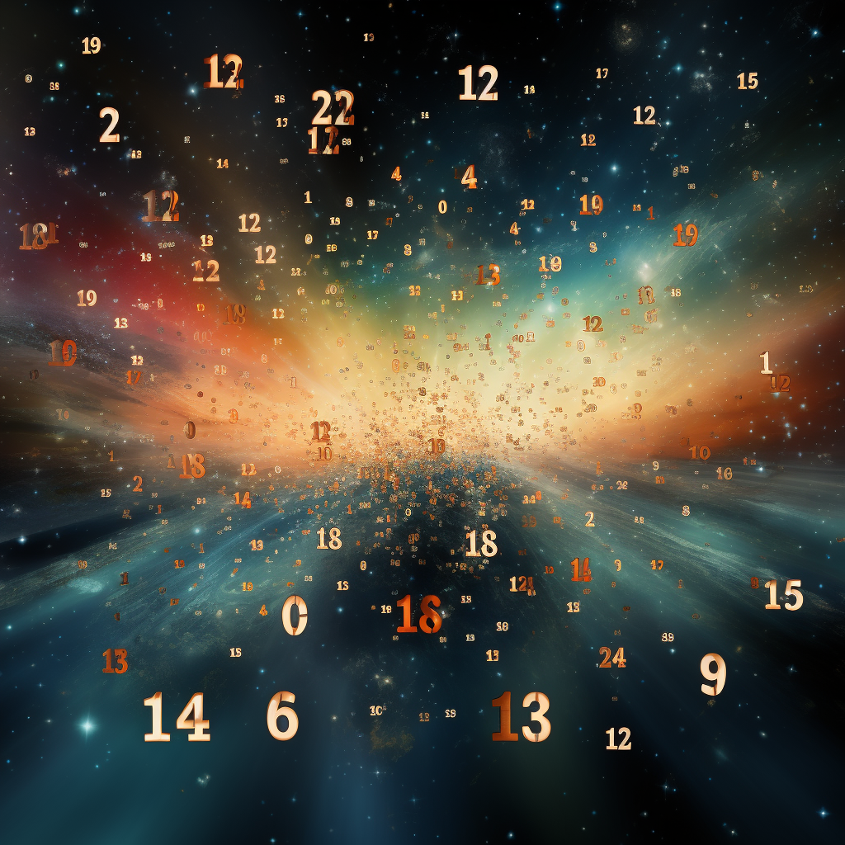
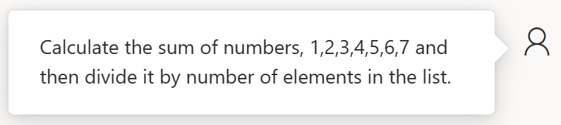

Slide 36
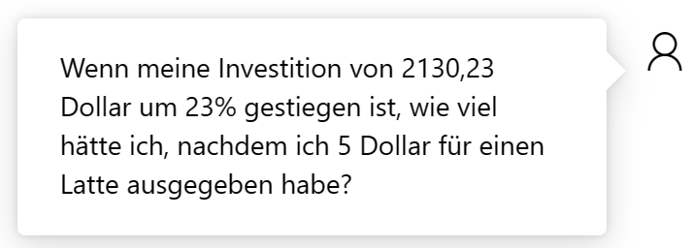
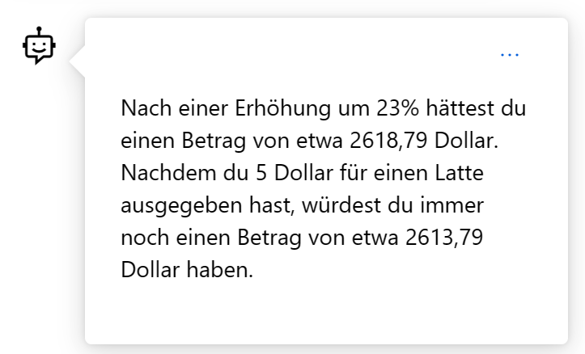

Slide 37

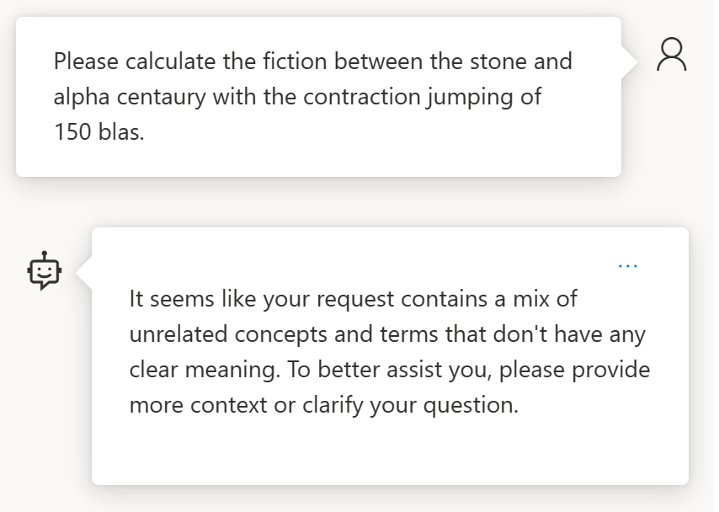
How about something not solvable?

Slide 38


References
Azure/aistudio-copilot-sample at oct-refresh (github.com)
Microsoft Copilot Studio
https://platform.openai.com/docs/models https://oai.azure.com/portal/****/models
Azure AI Studio
Semantic Kernel
AI-Generated 3D Worlds
Imagine AI Art Generator
Midjourney
Azure AI SDK - Azure AI Studio
BOOK OF NEWS - Microsoft Ignite

Slide 39
References
Open AI
https://platform.openai.com/docs/models
Azure Open AI https://oai.azure.com/portal/****/models
Request Access to Azure OpenAI Service (microsoft.com)

Slide 40
Azure OpenAI und Semantic Kernel für Softwareentwickler
Dr. Damir Dobric
Lead Software Architect daenet GmbH / ACP Digital
Microsoft Regional Director,
Most Valuable Professional: Azure + IoT

Slide 41
Microsoft confidential
Pause: 10.30-11.00
https://github.com/ddobric/semantic-kernel-training/settings/access

